Slide 1
Introduction
For this topic we will be focussing on the following:
Using PHP to Create a Complex Login Form
Creating a Database using MySQL
Creating a Table using MySQL
Populating a Table using MySQL
Using PHP to Create a Script that will allow us to View the content of our Table
Using PHP to Create a Complex Script to check the user’s Login details based on the data within the Database
We will now begin to focus on all of the above

Slide 2
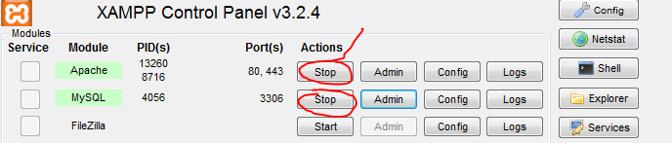
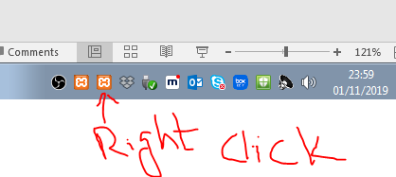
Pre-requisites
You must install XAMP first. Here is a tutorial to follow. You can install it on your USB, students drive or on your laptop.
https://www.youtube.com/watch?v=KxpTFF9MLAs
Warning: Once you finish the work, then you should stop XAMP by following steps
You must stop MySQL first and then Apache
2) You should quit XAMP. Notice icon of XAMP at the bottom right on windows bar. Right click and you will see quit option. Simply click on it.

Slide 3
Creating a Complex Login Form – Part 1
For this part you may use a copy of your previous login form (simpleLoginForm.php) – make sure that you go through the following process:
Make a copy of simpleLoginForm.php
Rename your copy to complexLoginForm.php
Change line 2 of complexLoginForm.php so that it contains complexLoginCheck.php instead of simpleLoginCheck.php
Once you have completed the above process you should end up with the code and the form on the next slide

Slide 4
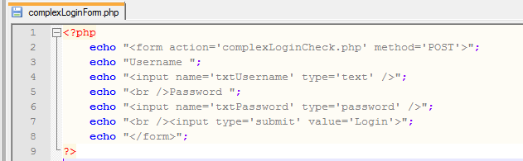
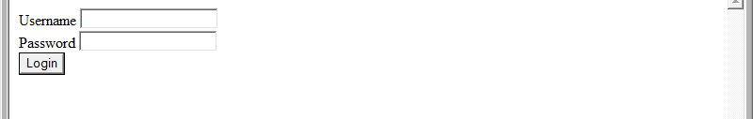
Creating a Complex Login Form – Part 2
The code:
The Form:

Slide 5
Creating a Database using MySQL – Part 1
The way that this version of the login will work will be that it checks a database to see if the User’s Login details are correct or not
The following process will happen when the User clicks on the Login button:
The Script will connect to the Database
The Script will check the SystemUser Table in the Database to see if the Username exists
If the Script finds the User then it will check the SystemUser Table to see if the Password matches the Username
If the Password matches then the User will have access to the System
If the Password does not match then a ‘Wrong Password’ message will appear
If the Script does not find the User then a ‘User not found’ message will appear

Slide 6
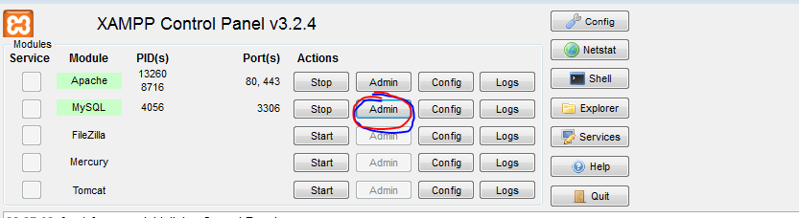
Creating a Database using MySQL – Part 2
Before we can write the Script that accesses the Table within the Database we will need to create the Database on our Server
Click on the Admin
Don’t get lost or worry if my screen shots are slightly different than yours. You should see the features but look and feel might be slightly different.

Slide 7
Extra resource
First watch this useful video and then create your own database
https://www.youtube.com/watch?v=5QHBj4brHNM

Slide 8
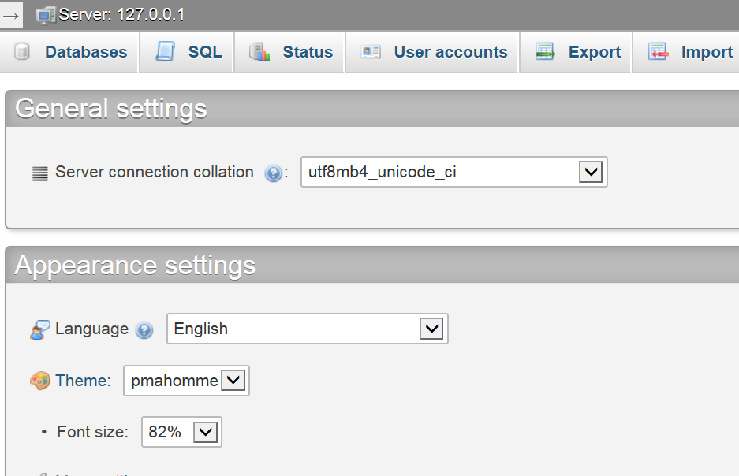
Creating a Database using MySQL – Part 3
You should now have the following screen:
This will allow you to create your Database as well as setup the security for your system

Slide 9
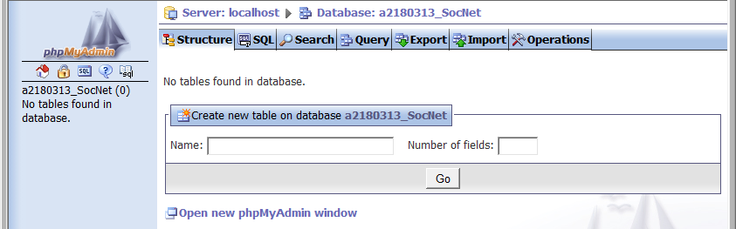
Creating a Table using MySQL –
You should now have the following screen:
This is where you will have to name your Table and you will also need to say how many fields you are going to include in your Table

Slide 10
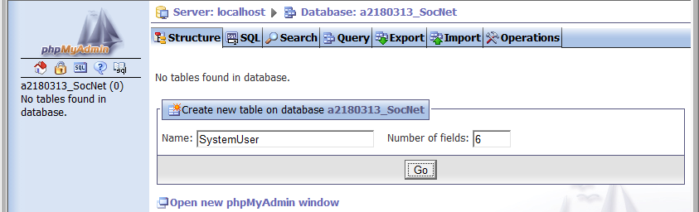
Creating a Table using MySQL – Part 4
I have used the following values:
Once you have entered your values then click on Go to continue
The Table will be called SystemUser
There will be 6 Fields

Slide 11
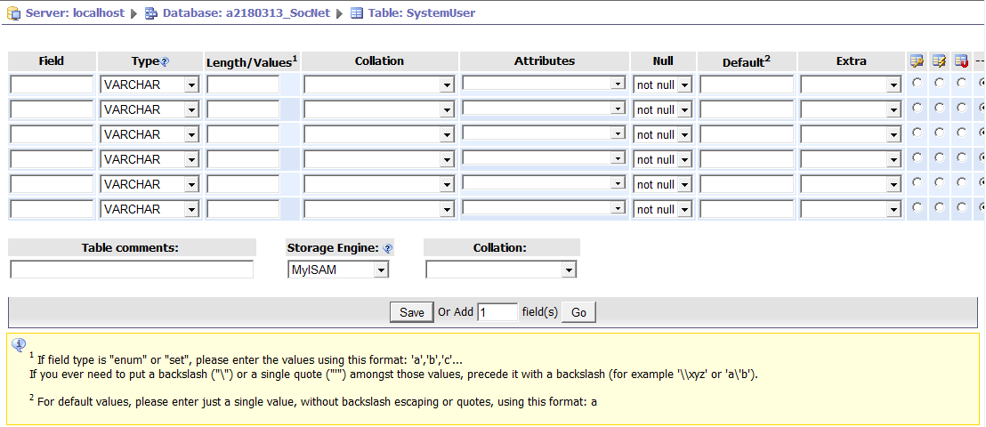
Creating a Table using MySQL – Part 5
You should now have the following screen:
This screen will allow you to name all of your Fields as well as determine their Data Types and other settings

Slide 12
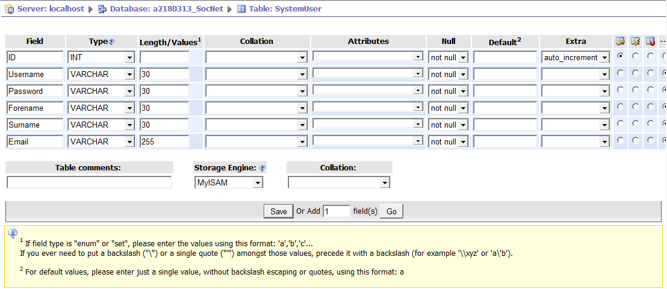
Creating a Table using MySQL – Part 6
I have used the following values for my Table:
Make sure that you use similar values for your Table and click on Save once you have finished
Make sure that you change this to auto_increment
And make sure that this is selected too!

Slide 13
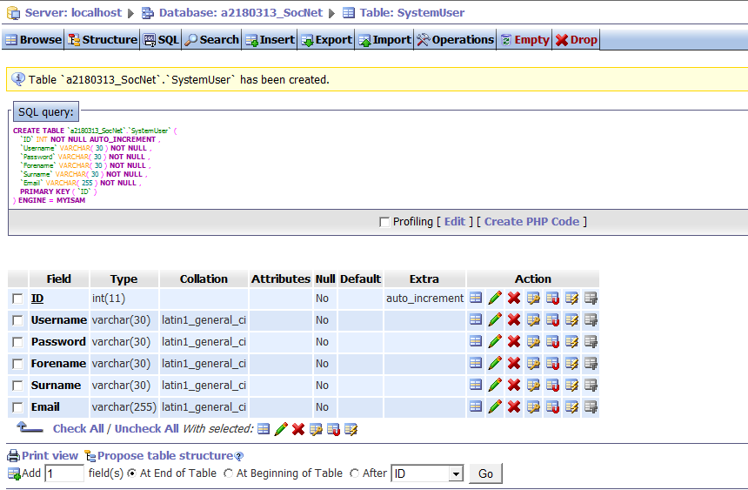
Creating a Table using MySQL – Part 7
You should now have the following screen:
This is the unique identifier for the Table and we will need to use this later on
The numbers in brackets show how many characters will be stored for each Field - For example: The Username can have up to 30 characters

Slide 14
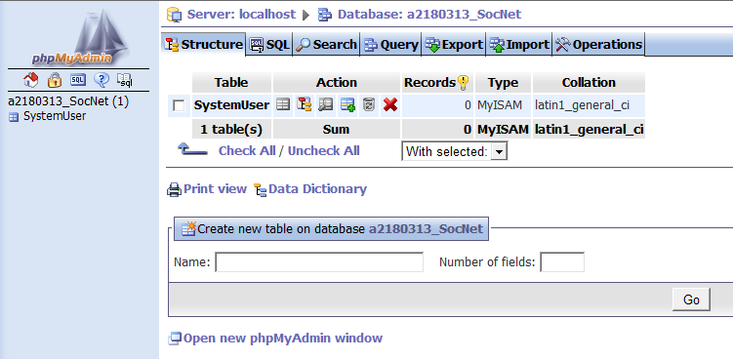
Populating a Table using MySQL – Part 1
Now that we have our SystemUser Table within our Database we will need to add some Data
Go back to phpMyAdmin and you should see this screen:
Click on the Insert icon to continue

Slide 15
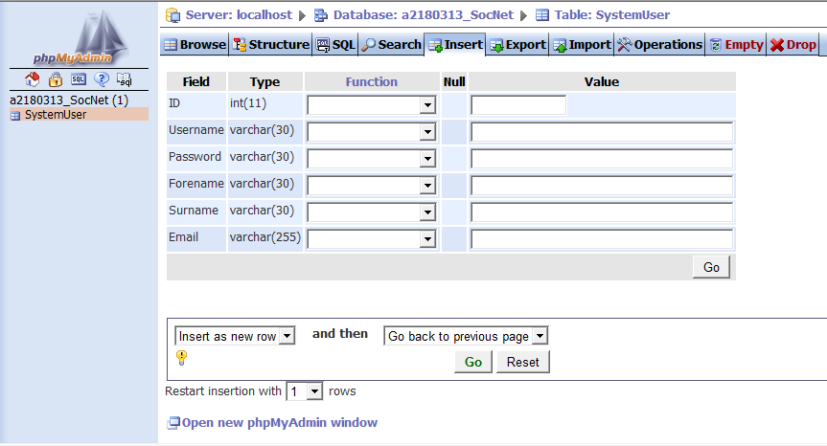
Populating a Table using MySQL – Part 2
You should now have the following screen:
Click on here and change it to 5 because we will be entering Data for 5 different users

Slide 16
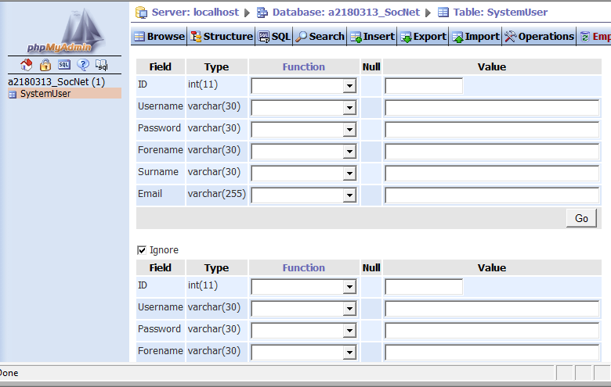
Populating a Table using MySQL – Part 3
You should now have the following screen:
This is where you can add the Data for each User

Slide 17
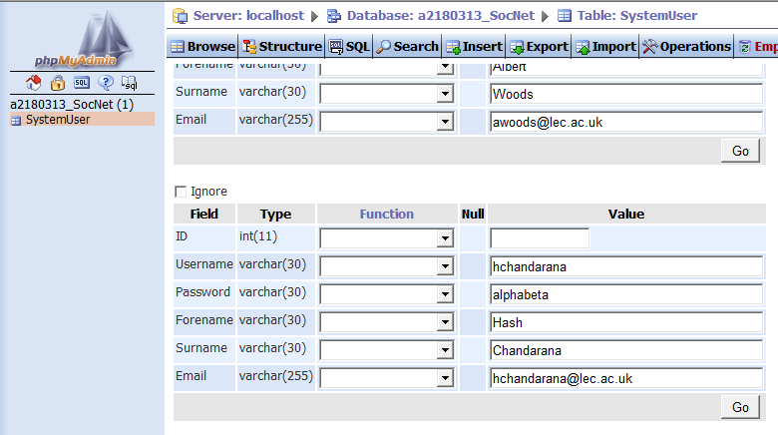
Populating a Table using MySQL – Part 4
I have now entered all of the Data for my 5 Users:
This is my 5th User that I have entered and the rest can be seen by scrolling up!
Leave all of the Ids blank because they will be automatically generated
Once you have added all of your Users, you will need to click on the Go button that belongs to your last User in order to continue

Slide 18
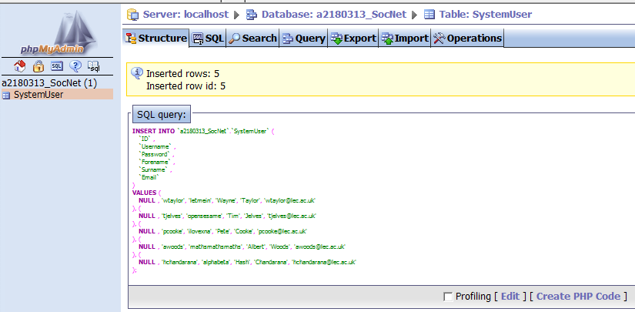
Populating a Table using MySQL – Part 5
You should now have a screen that looks similar to this:
This shows all of the Data that has been added to the Table in the Database

Slide 19
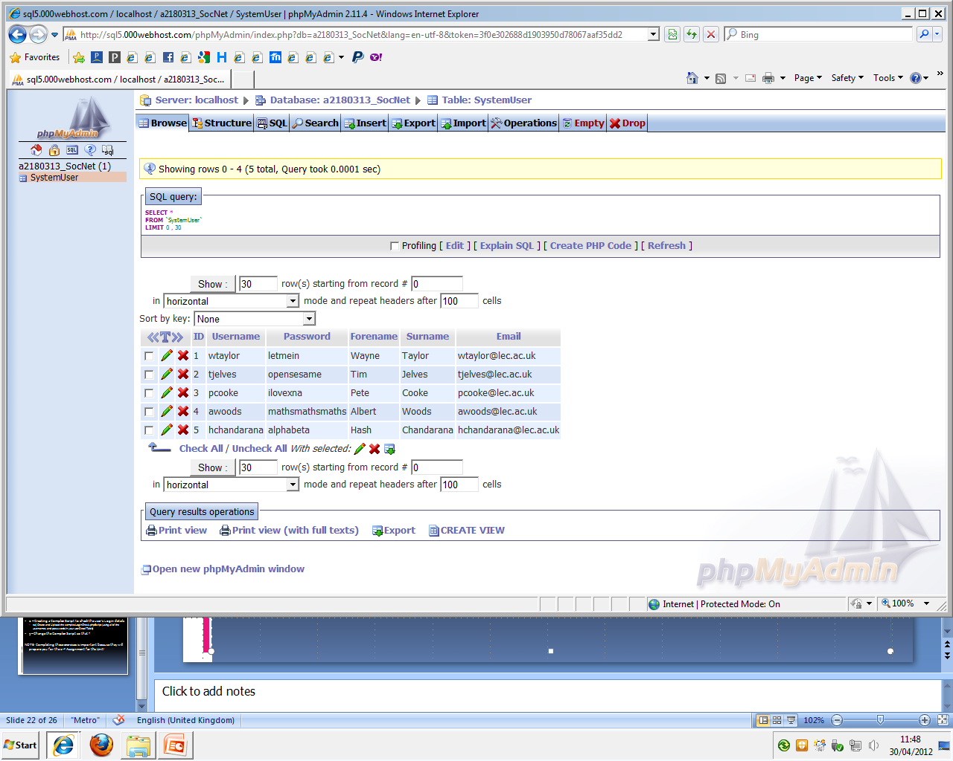
Populating a Table using MySQL – Part 6
One last step while we are within phpMyAdmin is to check our SystemUser Table to make sure it contains the Data we have added – You can do this by clicking on the Table name and then clicking on Browse:

Slide 20
Viewing a Table using a PHP Script – Part 1
In order to get used to connecting to a Database, searching through Records in a Table and Displaying the Data within each one – I am going to show you how to complete the following things using PHP:
Connecting to your Server
Selecting your Database
Finding Records (Users) within your SystemUser Table
Displaying all of your Records (Users) in a HTML Table within a Browser window

Slide 21
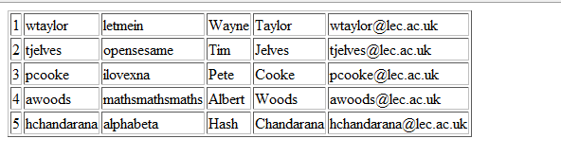
Viewing a Table using a PHP Script – Part 2
Once your PHP Script is working and running you should get something similar to the following screen within your Browser:

Slide 22
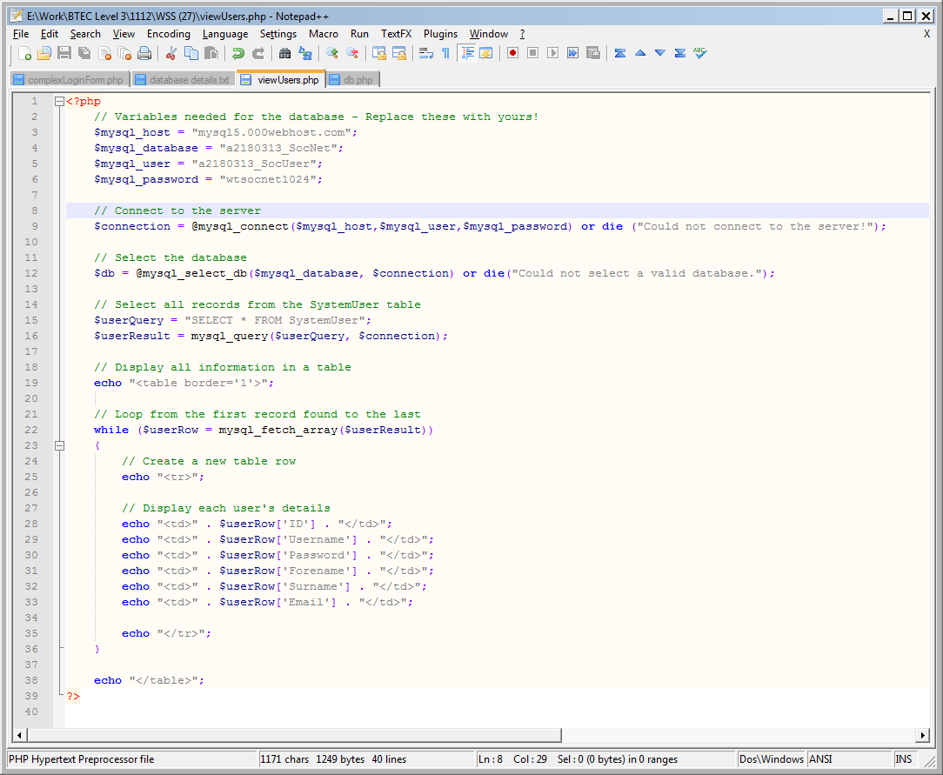
Viewing a Table using a PHP Script – Part 3
Here is the first part of the PHP Script that I have saved as viewUsers.php:

Slide 23
Viewing a Table using a PHP Script – Part 4
Here is the second part of the PHP Script that I have saved as viewUsers.php:

Slide 24
Creating a Complex Login Script – Part 1
At this point we have the following things:
A Database on our Server
A Table called SystemUser within our Database
5 User Records within our SystemUser Table
A working PHP Script that shows all of the Users within our System
The next step is to create a PHP Script that will check the details, that could be entered into the Form, that was created using a PHP Script (complexLoginForm.php) right at the start of this Presentation

Slide 25
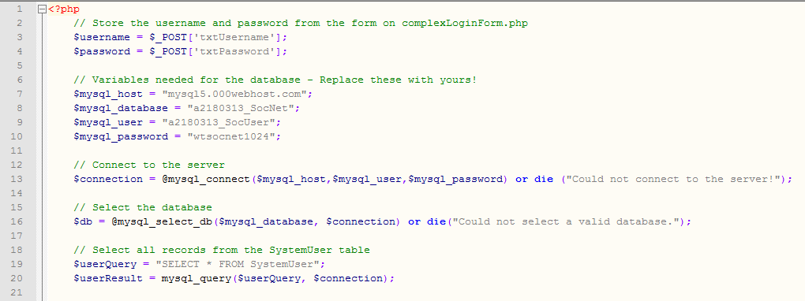
Creating a Complex Login Script – Part 2
Here is the first part of the complexLoginCheck.php Script, that will check the User’s Login details to see if the User exists within the SystemUser Table and if they do then it will check to see if the Password is correct:

Slide 26
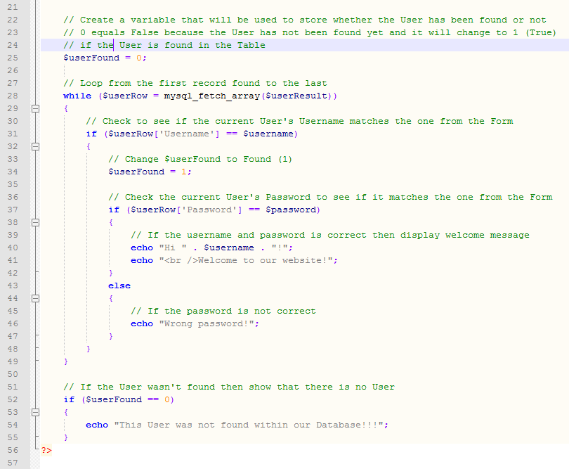
Creating a Complex Login Script – Part 3
Here is the second part of the Script:

Slide 27
Creating a Complex Login Script – Part 4
Testing the Script – Make sure that you test the Script for all of your Users:
Check to see if it finds all Users – Test one User at a time
Check to see if the Passwords work for all Users – Test one User at a time
Check to see if it displays the Wrong Password message for all Users by using an incorrect Password for each User – Test one User at a time

Slide 28
Exercises – Part 1
1 – Creating a Complex Login Form
1a) Create, Upload and Test the complexLoginForm.php Script
2 – Creating a Database using MySQL
2a) Create your Database on your Server
3 – Creating a Table using MySQL
3a) Create your SystemUser Table within your Database
4 – Populating a Table using MySQL
4a) Add at least 5 Users to your SystemUser Table

Slide 29
Exercises – Part 2
5 – Using PHP to Create a Script that will allow us to View the content of our Table
5a) Create, Upload and Test the complexLoginForm.php Script
6 – Creating a Complex Script to check the user’s Login details
6a) Create and Upload the complexLoginCheck.php Script
6b) Test the complexLoginCheck.php Script - Use all of the Usernames and Passwords in your SystemUser Table

